Slide 1

Q4-W2-D1
CRITICAL READING AS REASONING

Slide 2

”Blast from the Past”
Tell whether each statement is TRUE or FALSE.
1. An intertext refers to a work whose meaning is shaped by referencing or calling to mind other texts.

Slide 3

2. Hypertext may be the retelling or writing of an old story in modern context.

Slide 4

3. Appropriation is a type of intertextuality that adapts, borrows, reinterprets, or reimagines an existing text in
order to make it new.

Slide 5

4. An allusion is a reference to another text, a person, place or event. It may be literary, cultural, biblical, or
historical.

Slide 6

Objective:
Explain critical reading as reasoning

Slide 7



We read every day, consciously or unconsciously.
CRITICAL READING AS ACTIVE LEARNING
We do so to satisfy certain needs.
If we are convinced that such an act leads us to look for, analyze, and evaluate a text, then, you are actively engaged in learning.

Slide 8

+ As a reader, you are not a passive participant, but an
active constructor of meaning (Knott, 2012).

Slide 9

Exhibiting an inquisitive, critical attitude towards what you read will make anything you read richer and more useful to you in your classes and in your life.

Slide 10
When are you reading critically?
You read something and…
+ You evaluate claims.
+ You seek definitions.
+ You judge information.
+ You demand proof, and question assumptions.

Slide 11

Reading critically means you are thinking critically.
To arrive at a sufficient interpretation of a text, you need to become a critical and active reader.

Slide 12




Involves presenting a reasoned argument that evaluates and analyses what you have read.
Being critical, therefore- in an academic sense – means advancing your understanding, not dismissing and therefore closing off learning.
CRITICAL READING
When you read critically, you will be able to think critically. When you read critically, you dissect a reading material. You ask questions about the text.
If critical reading is well – developed, nurtured and enhanced, the reader will be challenged to reason out and justify his/ her thoughts, ideas and decisions.

Slide 13

A COMPARISON OF CRITICAL READING AND NON-CRITICAL READING

Slide 14

Non-Critical Reading
Purpose is to get a basic grasp of the text.
Activity is absorbing/ understanding.
Focus is on what the text says.
The question is:
What is the text
saying? What
info can I get?
Direction is With the text (taking for granted that it is right.
The response is a statement or a summary.

Slide 15

Critical Reading
Purpose is to form judgments about how the text works.
The activity is analyzing/interpreting/evaluating.
Focus is on what the text does and means.
The question is: How does the text work? What does the text mean?
The direction is against the text (questioning its assumptions and argument, interpreting meaning in context)
The response is a description, interpretation, evaluation

Slide 16

CRITICAL READING STRATEGIES

Slide 17




Critical Reading Strategies
1. Previewing ➢ Learning about a text before really reading it.
2. Contextualizing ➢ Placing a text in its historical, biographical and cultural context.
Questioning to Understand and Remember ➢ Asking questions about the context
Reflecting on Challenges to your beliefs and values
Identifying your personal response.

Slide 18



5. Outlining and Summarizing ➢ Identifying the main ideas and restating them in your own words.
Critical Reading Strategies
6. Evaluating an Argument ➢ Testing the logic of a text as well as its credibility and emotional impact.
7. Comparing and Contrasting Related Readings ➢ Exploring likeness and differences between texts to understand them better.

Slide 19

IMPORTANT CONCEPTS IN CRITICAL READING AS REASONING

Slide 20
INTERPRETATION is reading ideas as well as sentences.
We need to be aware of the …
cultural and historical context
INTERPRETATION
context of its author’s life
context of debates within the discipline at the time and
intellectual context of debates within the discipline today

Slide 21


EVALUATION
EVALUATION is making judgements about the intellectual/ cognitive, aesthetic, moral or practical value of a text.
When you evaluate…..
You look at the contribution of the text to the discipline as well as the originality of the main conclusions;
You also check if the evidences and reasoning support the theory/ ies presented;
You verify the reliability of the sources;
You look for logical consistency and the text’s ability to convince

Slide 22

REASONING
Is the process of expressing ideas and opinions as well as
justifying a stand based on prior
and existing knowledge and experiences needed to arrive at a decision.

Slide 23


Techniques to Develop Reasoning

Slide 24

1. Dare to read everyday.

Slide 25
2. Learn to focus on the main ideas (explicit or implied) as well as the supporting details.

Slide 26


3. Examine the pros and cons of your argument/resolution. This will help you weave the flow of your thoughts.

Slide 27

4. Organize your thoughts. Arrange ideas either in chronological order
or by emphasis.

Slide 28

5. Note points for improvement. Recheck your stand on an issue based on your ability to persuade. Practice constantly in order to become better at reasoning out.

Slide 29

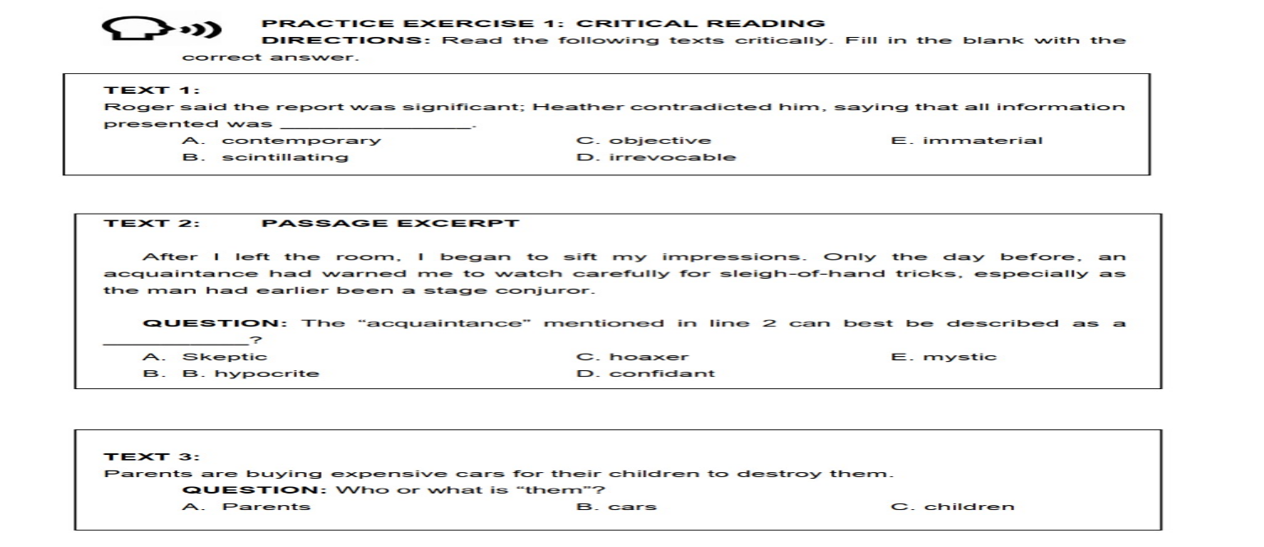
Let’s Practice:

Slide 30
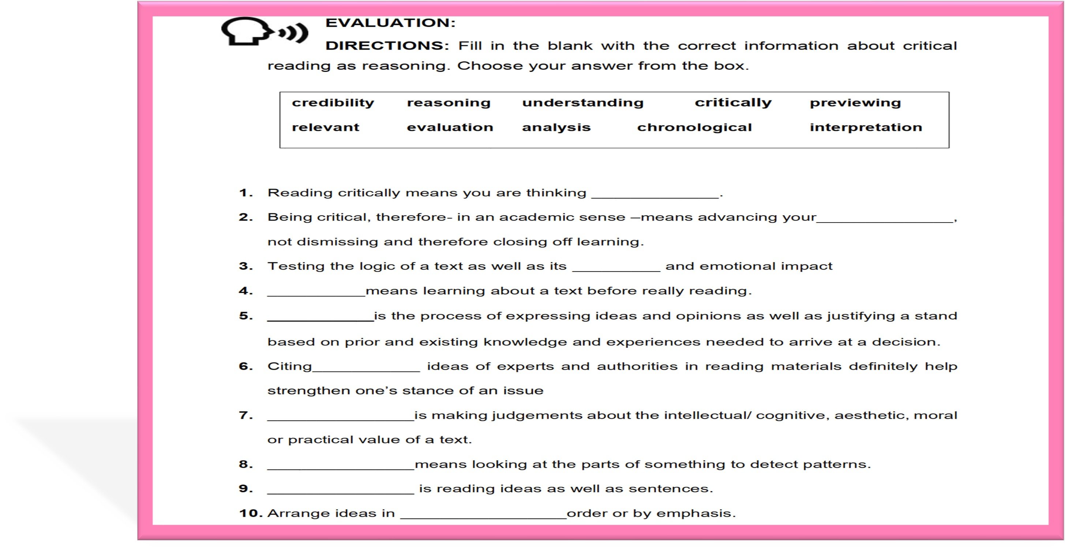
Your Task:

